Slide 1
Counterfactual Fairness Replication
By Potluri Gowtam, Kai Wu, Mingfei Zhou, and Oliver Penglase

Slide 2
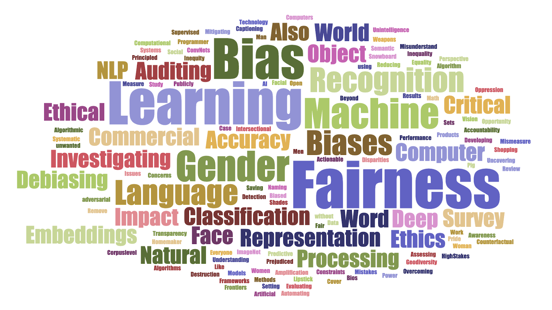
Introduction

Slide 3
What is fairness?
Fairness through unawareness – an algorithm does not use any protected attributes. If we have observations of a person’s race or sex we just ignore that information
Individual Fairness – an algorithm gives similar predictions to similar individuals. Similarity is determined through domain knowledge
Demographic Parity – an algorithm gives the same prediction no matter what the value of the given protected attribute is. P(Ŷ| A = 0) = P(Ŷ| A = 1)
Equality of Opportunity – an algorithm gives the same prediction given the outcome regardless of the protected attribute. P(Ŷ= 1| A = 0, Y = 1) = P(Ŷ = 1| A = 1, Y = 1)
Counterfactual Fairness – Had any individual been of a different race, sex, etc. the prediction would not change. P(Ŷ_{A←a} (U) = y | X = x, A = a) = P(Ŷ_{A←a’} (U) = y | X = x, A = a)
*Implication of counterfactual fairness*
A prediction will be counterfactually fair if it is a function of the non-descendants of a protected attribute (this precludes the use of the observed outcome in a prediction)

Slide 4
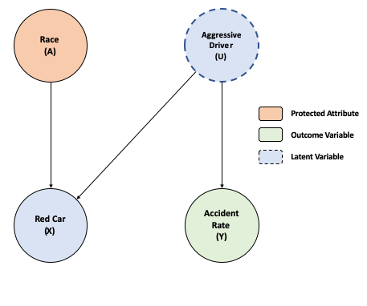
A Simple Example
Protected Attribute - Race (A) - Any attribute that should not be discriminated against
Observable Attribute - Red Car (X)
Outcome - Accident Rate (Y)
Latent Variable - Aggressive Driving (U)
Group A is more likely than other groups to drive a red car (X) but are not more likely to get into an accident (Y)
People who are more likely to be aggressive drivers (U) like to drive red cars as well
Using red car (X) as a predictor will lead to an unfair prediction as group A would be predicted to be more likely to get into an accident even though this is not the case

Slide 5
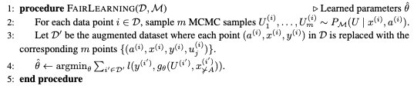
Fair learning Algorithm
In simple terms we are essentially extracting the latent variable from observed variables and then using that latent variable and non-descendents of the protected attribute in the predictive model.
As the authors say, “we are essentially learning a projection of T into the space of fair decisions, removing historical biases as a by-product ”. (p. 5)
Model M can take 3 levels of counterfactual assumption (most assumptions at level 3)
Level 1 – Determine from observable non-descendents of A
Level 2 – Determine through some non-deterministic latent variable (This is what we replicate)
Level 3 – Determine through some deterministic latent variables (not discussed in great detail)

Slide 6
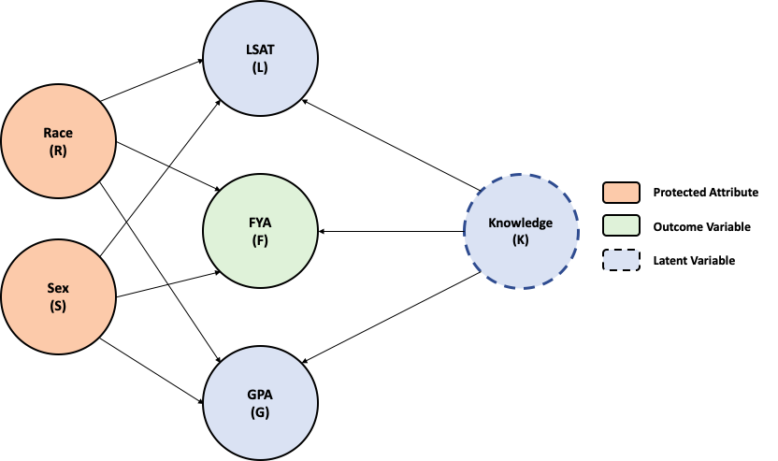
Law School Success
Protected Attributes - Race (R), Sex (S)
Observable Attributes - LSAT (L), GPA (G)
Outcome - FYA - First Year Average (F)
Latent Variable - Knowledge (K)
Example in authors paper comes from real observed data on low school applicants
Data used in replication is created from a model created in Pyro
The goal of a school creating this model would be to predict if an applicant will have a high first year average

Slide 7
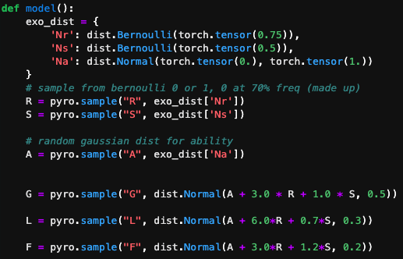
Law School Model
Synthetic data generated from the distributions on the right. For simplicity data is defined as follows:
Race (R) - Binary variable
Sex (S) - Binary variable
Knowledge (K) - Normal distributed variable indicating a applicants unobserved knowledge or ability
LSAT (L) - Normally distributed variable, function of Race, Sex and Knowledge. Entrance exam score
GPA (G) - Normally distributed variable, function of Race, Sex and Knowledge. GPA prior to law school
FYA (F) - Normally distributed variable, function of Race, Sex and Knowledge. First Year Average in Law school

Slide 8
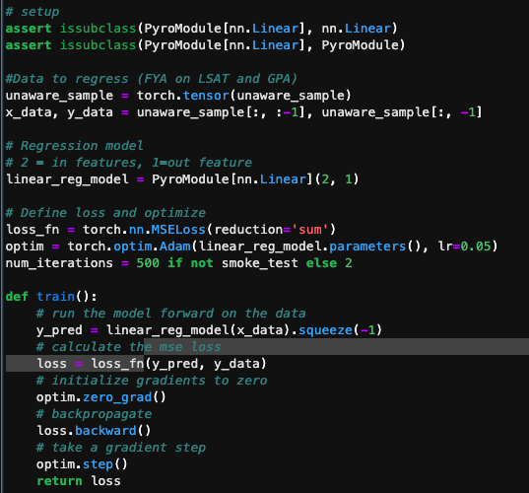
Unaware/Full Model Code
Use Pyros linear regression to get parameters and determine predicted values of FYA
Full model uses all observable data
Unaware models only uses non-protected observable attributes (LSAT and GPA)
Both models result in unfair predictions
See results on next two slides

Slide 9
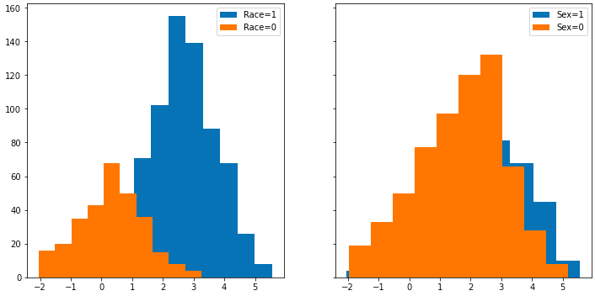
Full Model: Density plots separated out by protected attributes
Predicted FYA

Slide 10
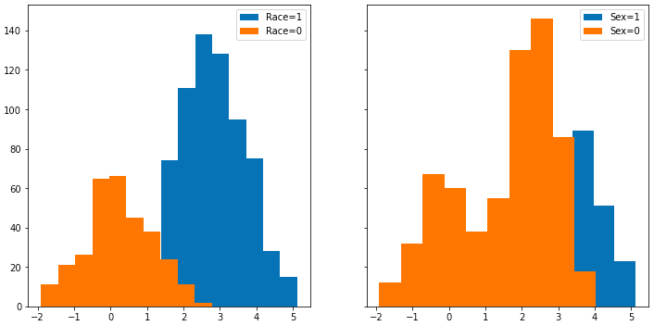
Unaware Model: Density plots separated out by protected attributes
Predicted FYA

Slide 11
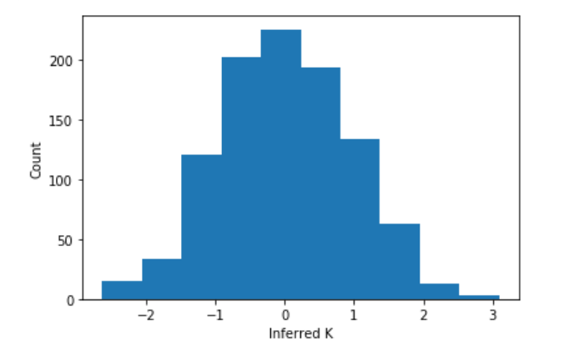
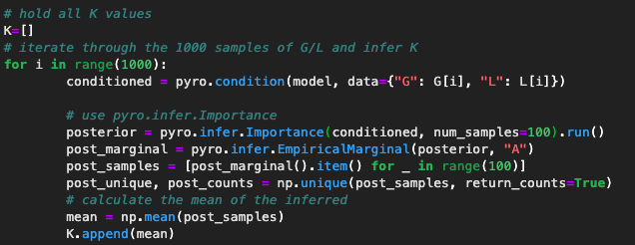
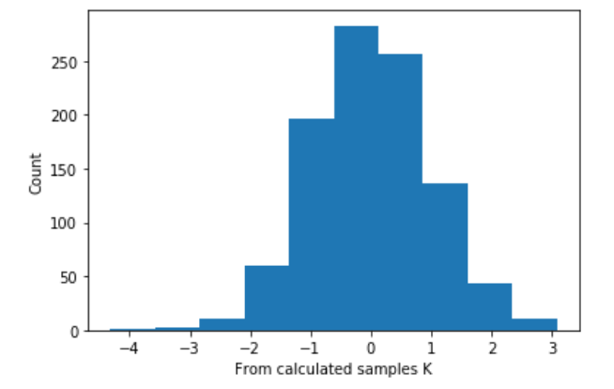
Fair Model: Inferring K
Following the fairness algorithm we infer the values of K given the observed variables LSAT (L) and GPA (G)
We can see how closely the inferred K's managed to be to the "actual" K's (which we technically can never know).
See next slide for resulting density plot from regression of FYA on inferred K

Slide 12
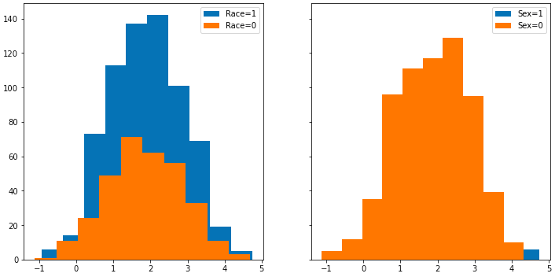
Fair Model: Density plots separated out by protected attributes
Predicted FYA

Slide 13
Conclusions
After the previous implementation of the counterfactual fairness, we take the protected attributes into consideration, so we are able to take into account the different social biases that may arise towards individuals based on ethically sensitive attributes and compensate for these biases effectively. In our implementation, we are able to capture these social biases and make clear the implicit trade-off between prediction accuracy and fairness in real life situations.
We believe that fairness should be regulated by explicitly modeling the causal structure of the world. Simply relying on probabilistic independence cannot meet the fair standard, it also cannot point out why and how unfairness is occurring. By implementing the previous counterfactual fairness models, we are able to provide practical solutions for solving a wide array of fairness modeling problems.
Original Paper: Counterfactual Fairness by Matt Kusner, Joshua Loftus, Chris Russell, and Ricardo Silva

Slide 14
Thank you

